Slide 1
LabChat
Hanna Schulze, Oliver Wagner
Cloud Computing WS 18/19

Slide 2
Agenda
Identified issues
Solution
Problems
Lesson-learnt
Live Demo
LabChat
Hanna Schulze, Oliver Wagner //Cloud Computing WS 18/19

Slide 3
Identified Issues
Each instance of a server has it‘s own usermap for saving active users
  Multiple instances can‘t communicate with each other
No implementation for failover
  2 running instances don‘t know from each other
Cloud SQL
I1
I2
I3
usermap
usermap
usermap
LabChat
Hanna Schulze, Oliver Wagner //Cloud Computing WS 18/19

Slide 4
Solution
Using Redis
  ioredis: Node library of redis (unofficial)
  Socket.io-redis: broadcasting / emit over all instances
Cloud SQL
I1
I2
I3
Redis
LabChat
Hanna Schulze, Oliver Wagner //Cloud Computing WS 18/19

Slide 5
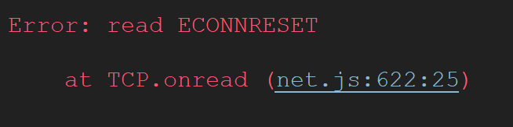
Problems
Connecting Node-App with the Redis instance on bluemix failed
  Followed the guide from IBM step by step but no success
LabChat
Hanna Schulze, Oliver Wagner //Cloud Computing WS 18/19

Slide 6
Problems
Instead using Redis instance from “Redis4You”
  After 5 connections, restart of the instance is necessary
  Sudden crashes of the instance happen pretty often
  →hard to do Live-Tests
LabChat
Hanna Schulze, Oliver Wagner //Cloud Computing WS 18/19

Slide 7
Lesson-learnt
Using multiple instances of an application is crucial for providing high availability
Considering scale-out of an app from the beginning prevents a lot of re-coding
LabChat
Hanna Schulze, Oliver Wagner //Cloud Computing WS 18/19

Slide 8
Live Demo
https://objective-euler.mybluemix.net/
LabChat
Hanna Schulze, Oliver Wagner //Cloud Computing WS 18/19

